Slide 1
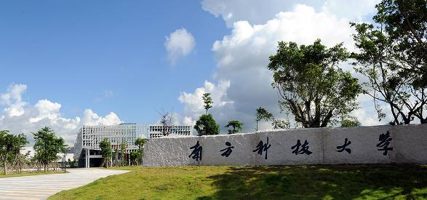
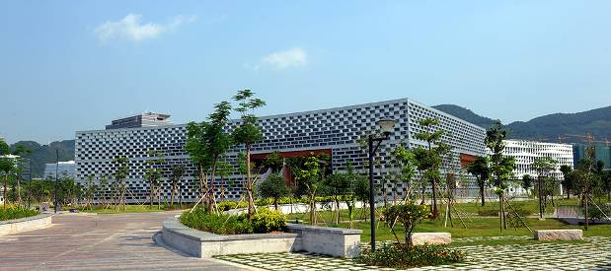
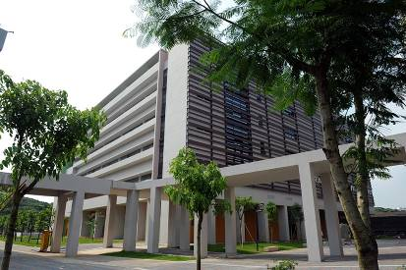
Engineering Electromagnetics 工程电磁场
Youwei Jia 嘉有为

Slide 2

8: Energy and Potential能量与电位
Point charge in an external field 外场中的点电荷
To move charge Q against 逆着 the electric field, a force must be applied
that counteracts 克服 the force on Q that arises from the field:
E
+
Q
F_{appl}
F_{appl} = - Q E
1

Slide 3
8: Energy and Potential能量与电位
Differential work 功 done on moving a point charge against an external field
In moving point charge Q from initial position B over a differential
distance dL (to final position A), the work expended is:
A (final)
B (initital)
E
F_{appl}
+
dL
+
dL
.
dW = F_{appl} dL = QE dL = -QE dL [J]
Note: Herein, the path is along an electric field line (in the opposite direction),
and over the differential path length, the field can be assumed constant.
2

Slide 4
8: Energy and Potential能量与电位
Forcing a charge against the field in an arbitrary direction 任意方向
What matters now is the component of force in the direction of motion.
A
+
Force magnitude is F_{appl} cos(α)
dL
B
α
E
F_{appl} = -Q E
+
Differential work in moving charge Q through distance dL will be:
.
dW = F_{appl} cos(α) dL = −QE dL [J]
3

Slide 5
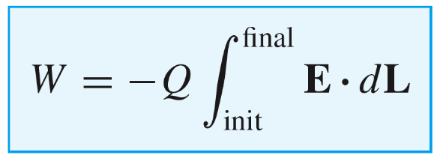
8: Energy and Potential能量与电位
Forcing a charge against the field in an arbitrary direction 任意方向
Total work done--All differential work contributions along the path are summed to give:
A (final)
+
dL
B (initial)
α
E
F_{appl} = -Q E
+
Note: The path must be specified before the integral can be evaluated.
4

Slide 6
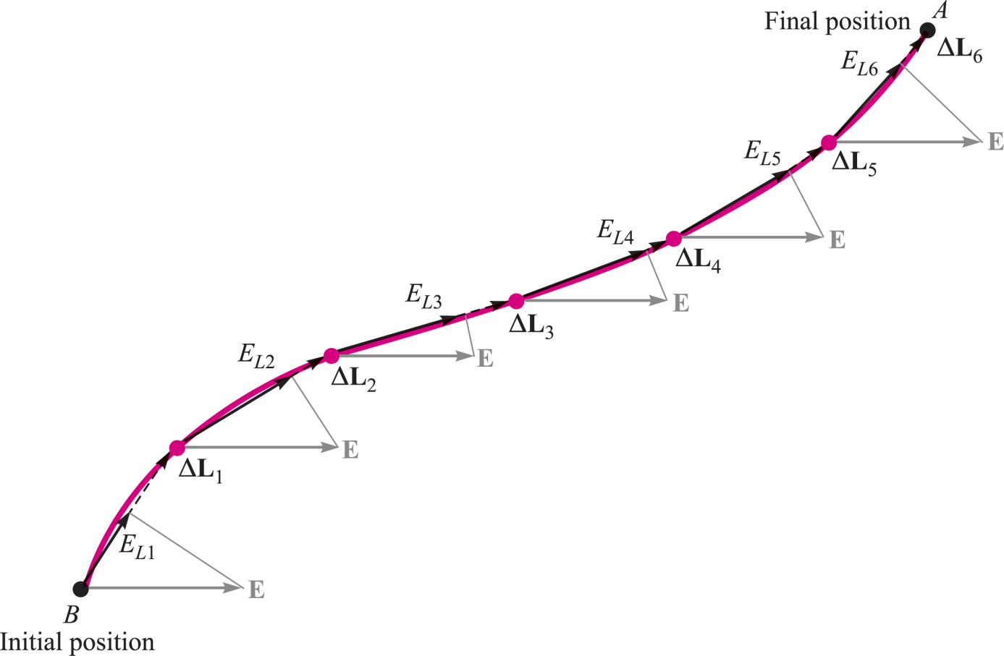

8: Energy and Potential能量与电位
Total work done over an arbitrary path
The integral expression for work is completely general: Any shape path may be
taken, with the component of force evaluated on each differential path segment.
The integral expression involving the scalar product of the field with a differential path vector is called a line integral or a contour integral.线积分
5

Slide 7
8: Energy and Potential能量与电位
Total work done over an arbitrary path
The integral expression for work is completely general: Any shape path may be
taken, with the component of force evaluated on each differential path segment.
A uniform electric field 均匀电场 is selected for simplicity. The path is divided into six segments, L₁,L₂, . . . , L₆, and the components of E along each segment are denoted by E_{L1}, E_{L2}, . . . , E_{L6}.
6

Slide 8
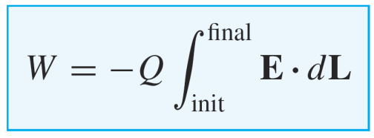
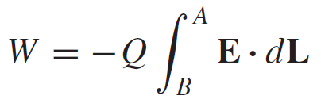
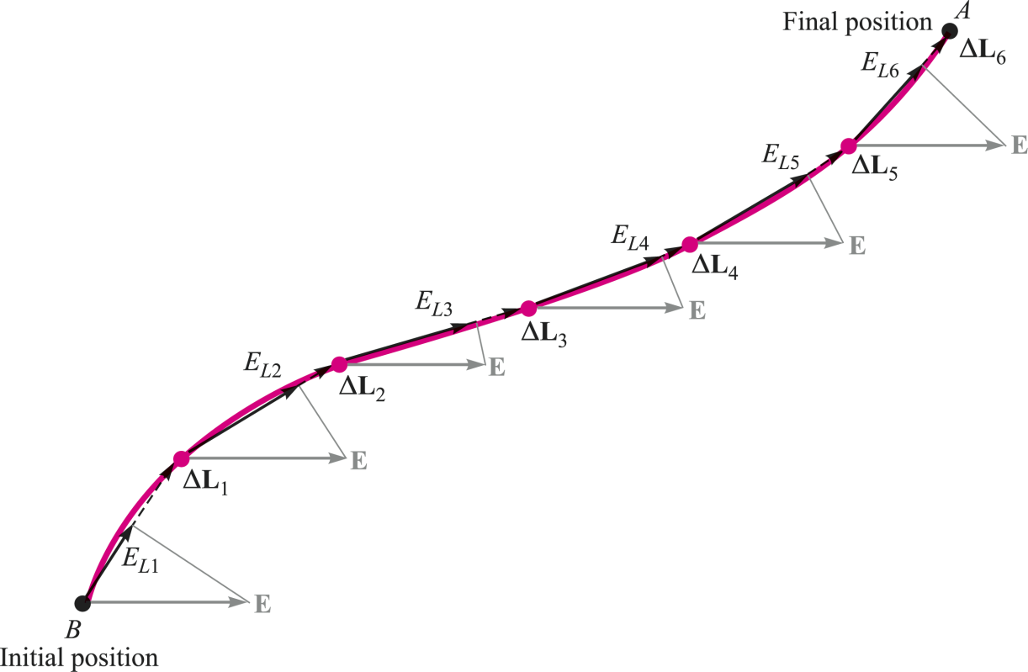
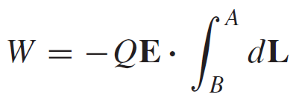

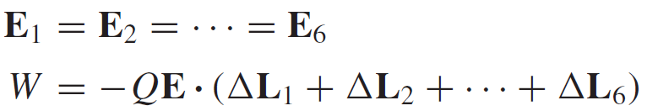

8: Energy and Potential能量与电位
Total work done over an arbitrary path
Note: In a uniform electric field, the work involved in moving a charge does not
depend on the particular path we have selected along which to carry the charge.
7

Slide 9
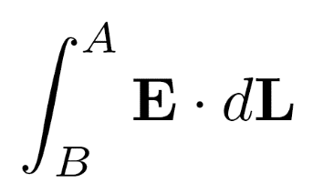


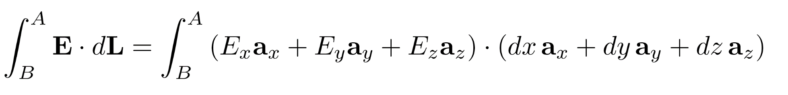
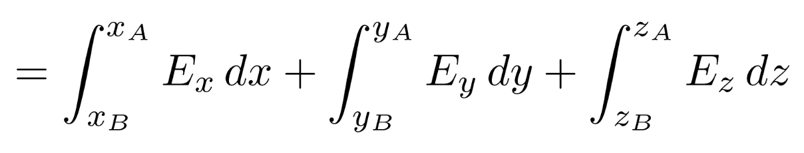
8: Energy and Potential能量与电位
Line Integral Evaluation 线积分计算
We wish to find:
where
and
using these:
8

Slide 10
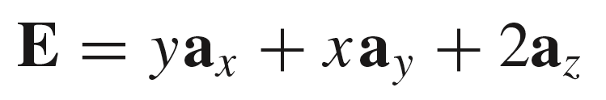
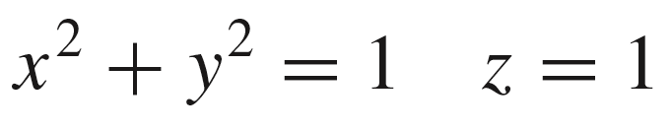
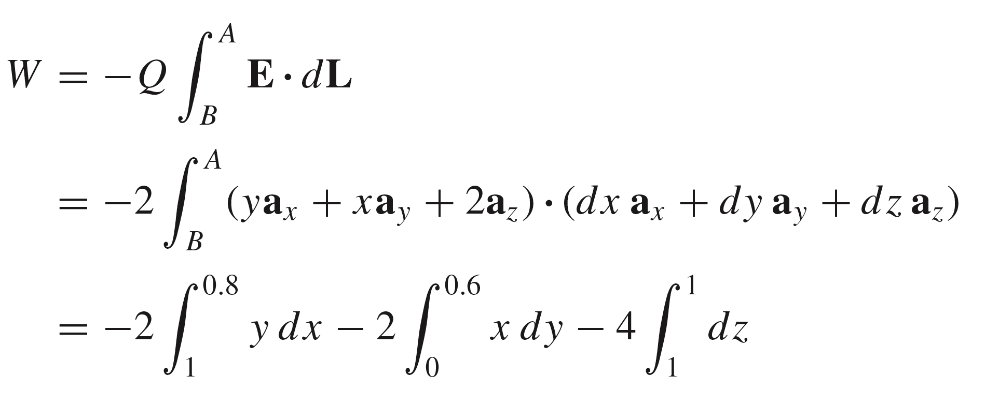
8: Energy and Potential能量与电位
Example
An electric field is given as:
We wish to find the work done in moving a point charge of magnitude Q = 2C over the shorter arc of the circle given by
z
The initial point is B(1, 0, 1) and the final point is A(0.8, 0.6 ,1):
B
A
y
x
This is the basic setup, in which the path has not yet been specified.
9

Slide 11
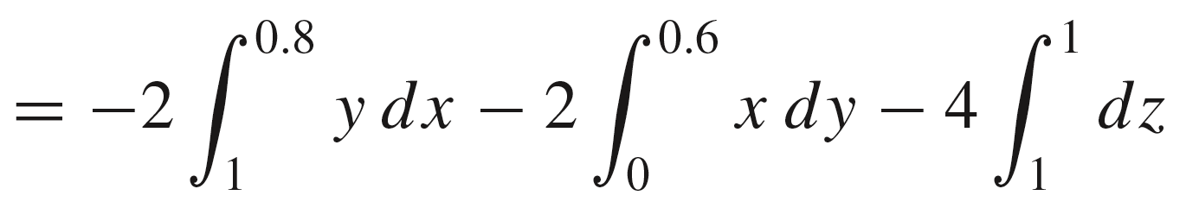
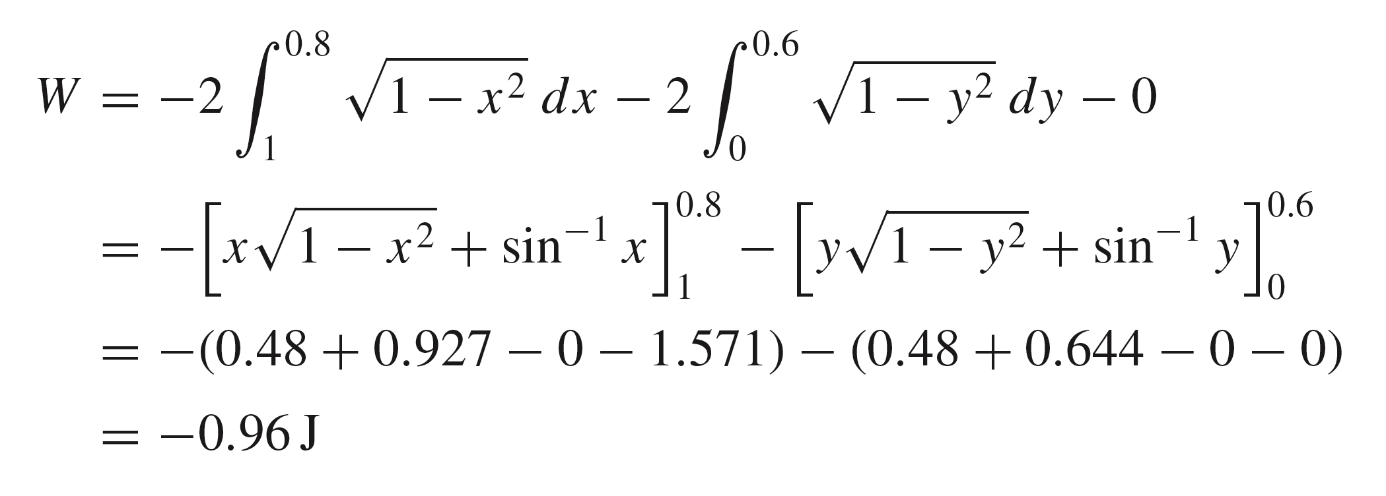
8: Energy and Potential能量与电位
Example (Cont.’d)
We now have
W
Note that the third integral vanishes because there is no motion along the z direction, and we need to include the y dependence on x in the first integral, and the x dependence on y in the second integral:
Using the given equation for the circular path, , we rewrite the
integrals:
10

Slide 12
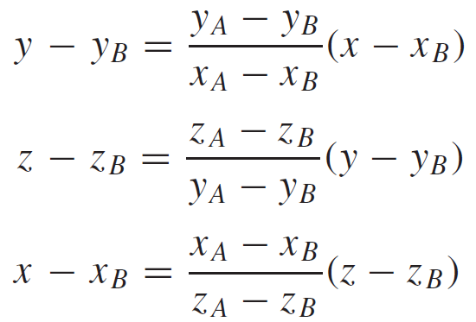


8: Energy and Potential能量与电位
Example (Cont.’d)
Again find the work required to carry 2C from B to A in the same field, but this time use the straight-line path from B to A.
We start by determining the equations of the straight line. Any two of the following three equations for planes passing through the line are sufficient to define the line:
z
B
A
y
x
11

Slide 13
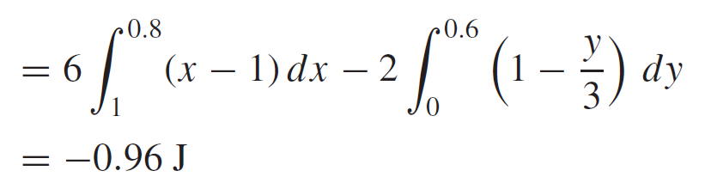
8: Energy and Potential能量与电位
Example (Cont.’d)
Again find the work required to carry 2C from B to A in the same field, but this time use the straight-line path from B to A.
The initial point is B(1, 0, 1) and the final point is A(0.8, 0.6 ,1):
z
B
A
y
x
Note: It again demonstrates the statement (unproved) that the work done
is independent of the path taken in any electrostatic field.
12

Slide 14
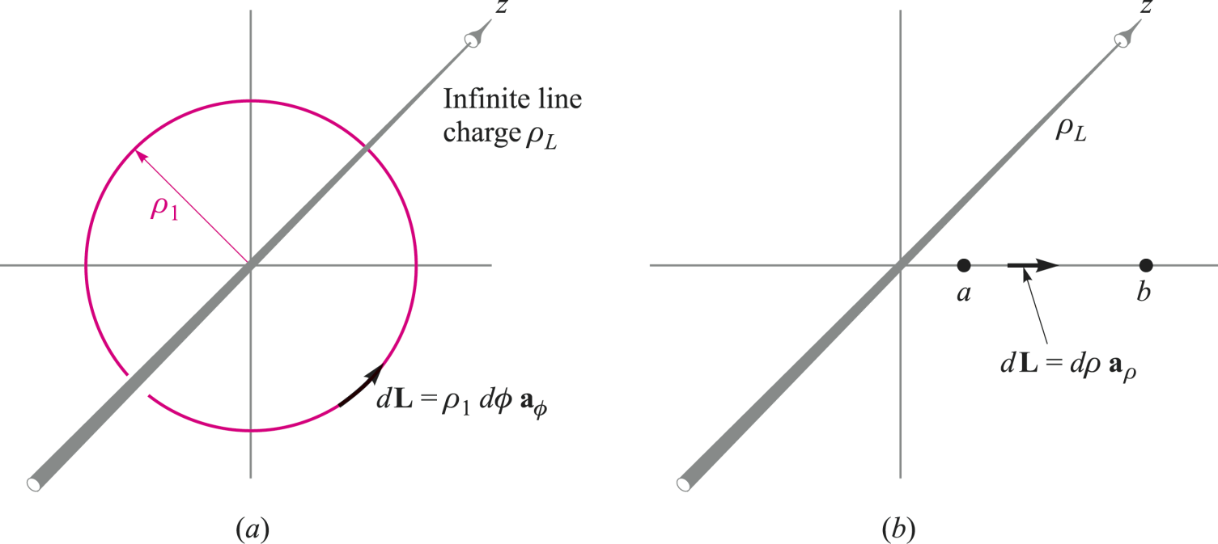
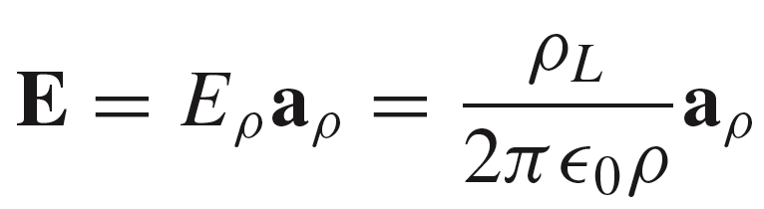
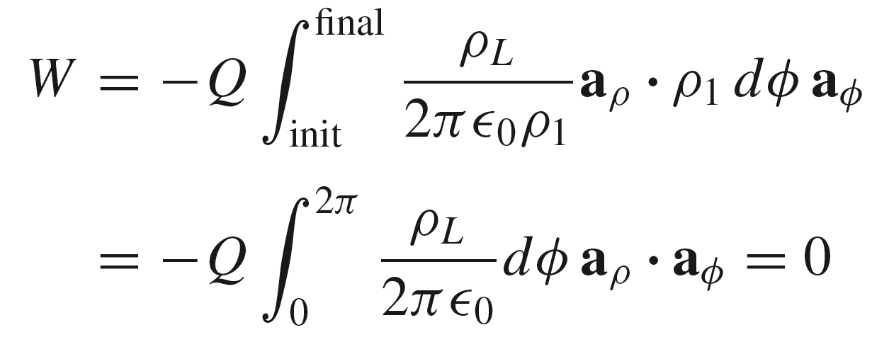
8: Energy and Potential能量与电位
Another Example: Evaluating work within a line charge field
In this example, the work in moving charge Q in a circular path around a line charge is found:
where
13

Slide 15

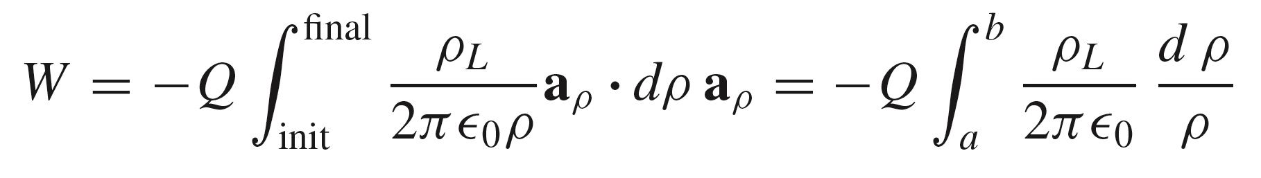
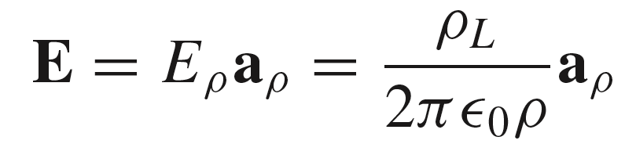
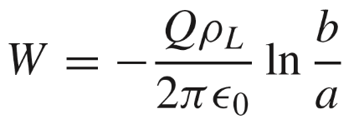

8: Energy and Potential能量与电位
Another Example: Evaluating work within a line charge field
In this example, the work in moving charge Q in radial direction near a Line charge is found:
so that finally:
Suppose we carry Q from b to a, We still have dL = dρ a_{ρ} and show the different direction by recognizing ρ = b as the initial point and ρ = a as the final point,
14

Slide 16
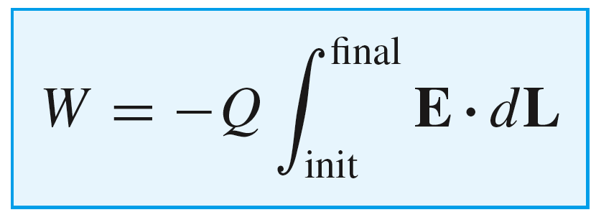
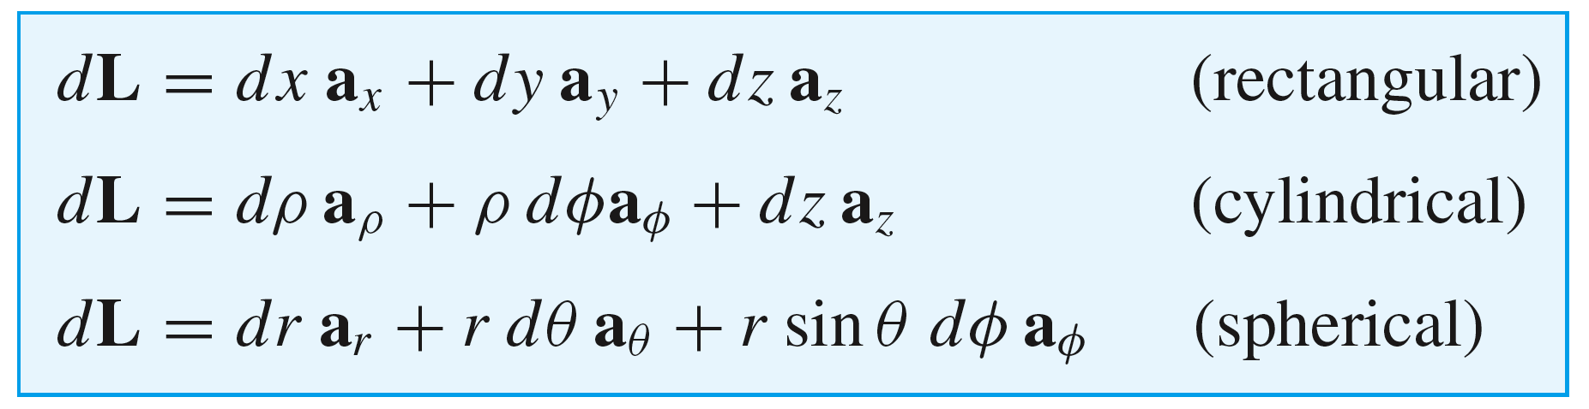
8: Energy and Potential能量与电位
Differential path lengths in three coordinate systems
15

Slide 17
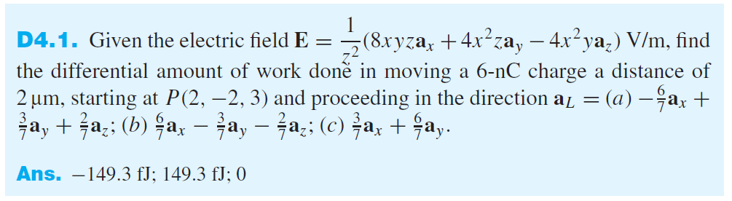
8: Energy and Potential能量与电位
.
dW = F_{appl} dL = QE dL = -QE dL [J]
16

Slide 18
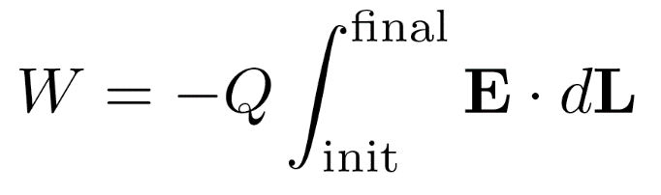
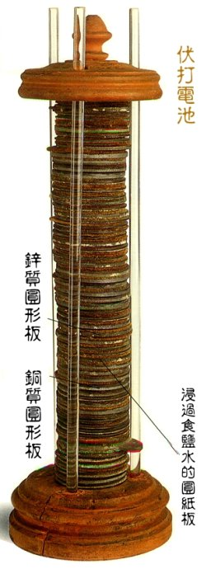
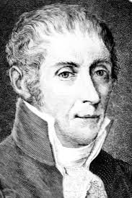
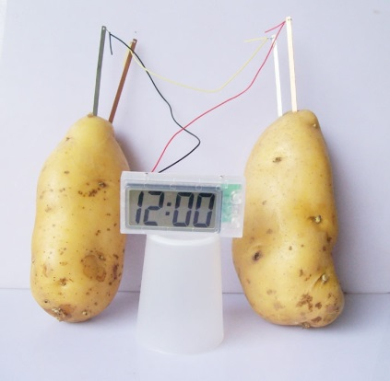
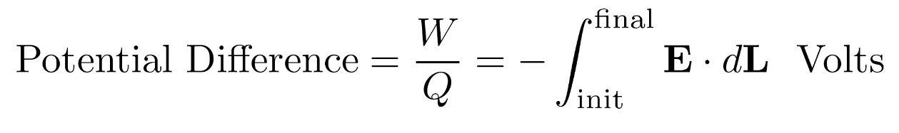
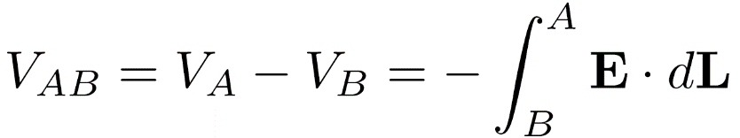
8: Energy and Potential能量与电位
Definition of Potential Difference
We now have the work done in moving charge Q
from initial to final positions. This is the potential
energy 势能 gained by the charge as a result of this
position change.
The potential difference 电位差 is defined as the work done (or potential energy gained) per unit positive charge. 外源把单位正电荷从电场中一点移到另一点所做的功
We express this quantity in units of Joules/Coulomb 焦耳/库, or volts 伏特:
Finally:
Alessandro Volta (1745-1827)
Note: Please compare the height difference in gravitational field with the potential
difference in electrostatic field.
17

Slide 19
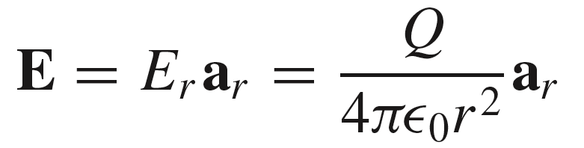
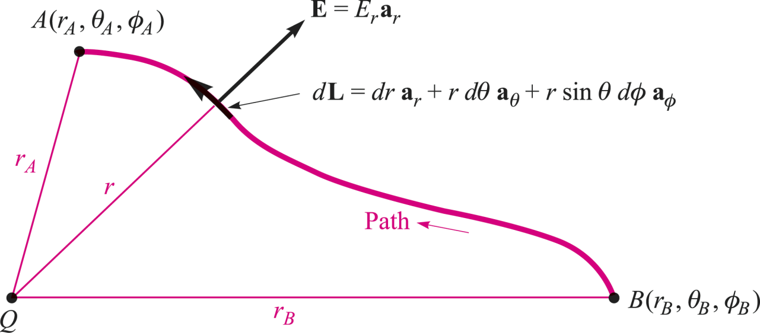
8: Energy and Potential能量与电位
Potential difference in a point charge field
In this exercise, we evaluate the work done in moving a unit positive charge from point B to point A, within the field associated with point charge Q
where
r_{A}
.
B
.
r_{B}
and where in general:
A
+
Q
18

Slide 20
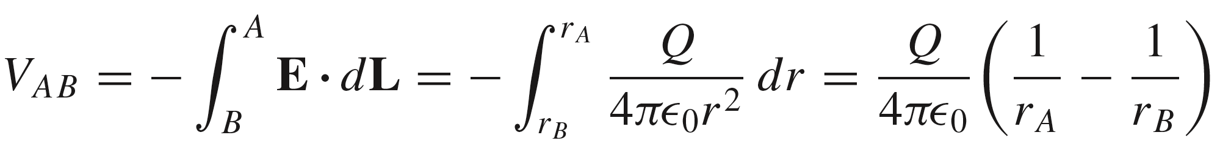

8: Energy and Potential能量与电位
Potential difference in a point charge field
In this exercise, we evaluate the work done in moving a unit positive charge from point B to point A, within the field associated with point charge Q
where
r_{A}
.
B
.
r_{B}
and where in general:
A
+
Q
19

Slide 21
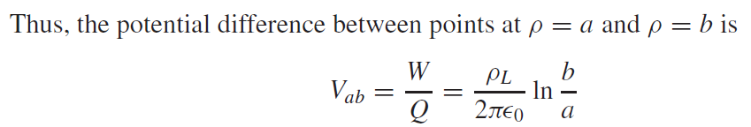
8: Energy and Potential能量与电位
Potential difference in a line charge field
20

Slide 22
8: Energy and Potential能量与电位
Potential, or Absolute Potential 电位，绝对电位
It is often convenient to speak of the potential, or absolute potential, of a point, rather than the potential difference between two points, but this means only that we agree to measure every potential difference with respect to a specified reference point that we consider to have zero potential. 要求我们定义一个参考零电位点/面，如同重力场中的海平面（海拔高度=0）
Perhaps the most universal zero reference point in experimental or physical potential measurements is “ground,” 大地 by which we mean the potential of the surface region of the earth itself.
Another widely used reference “point” is a point which is infinitely far away (infinity). 无穷远处的点
r_{A}
.
B
.
r_{B}
A
Q
+
21

